Slide 1

“Partnership for Energy and Sustainable Development”
Presented by:
Mr. Bharat Rohra & Mr. gaurav agarwal
President & CEO – Power
Africa power projects

Slide 2
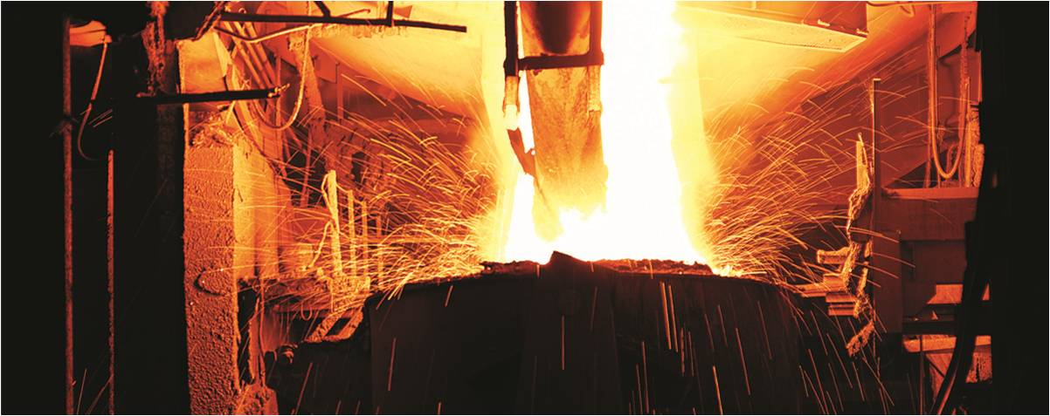
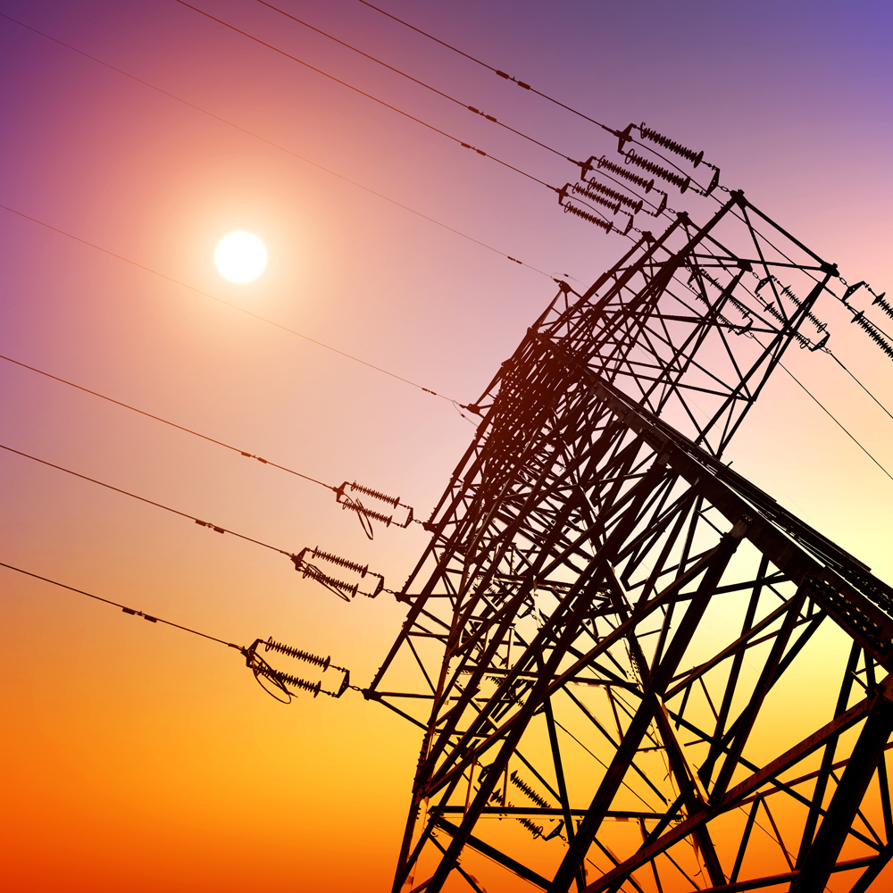
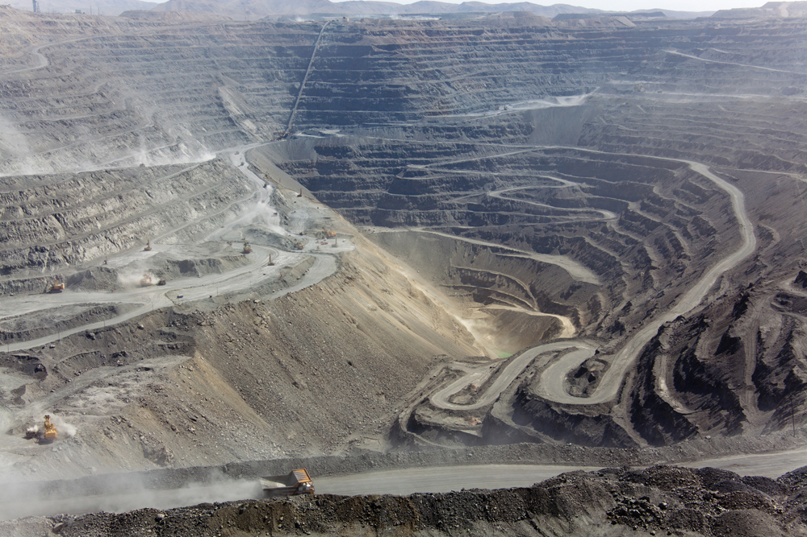

Jindal Steel and Power Ltd.
Jindal Steel & Power Limited (JSPL) is a major player in steel, power and mining
Captive coal mines -Dongamahua and Tamnar (Chhattisgarh)
Iron ore mine - Tensa, Odisha and iron ore pelletisation plant at Barbil, Odisha
Also present in Asia, Africa, Australia and Europe
Revenues of US$3.60bn and cash profits of US$0.84bn (FY Mar’13)
Market capitalization of US$3.67bn as on November 6, 2013.
Business segments
Steel & Cement
Power
Mines & Minerals
Global Venture
Steel: 3MTPA
Hot Briquetted Iron: 1.5MTPA
Pellet Plant: 4.5 MTPA
Operational: 2,437MW
Iron ore: 2 MTPA
Coal: 13 MTPA
Asia
Africa
Australia
Europe
Current Capacity
Steel: 6.6MTPA
Hot Briquetted Iron: 1.5 MTPA
Pellet Plant: 9.0 MTPA
Operational: 4507MW
Iron ore: 2 MTPA
Coal: 16 MTPA
Asia
Africa
Australia
Europe
Capacity as on 31st March 2014
Notes:
To Check on Capacity. Mention Oman’s capacity in GV

Slide 3
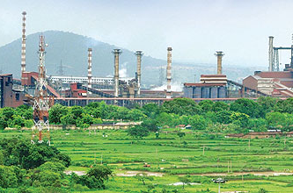
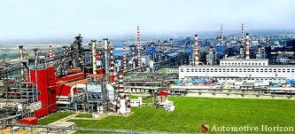
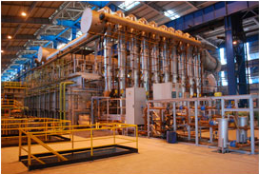
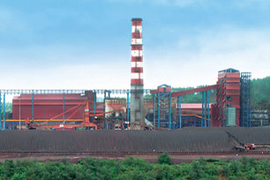
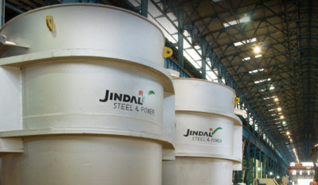
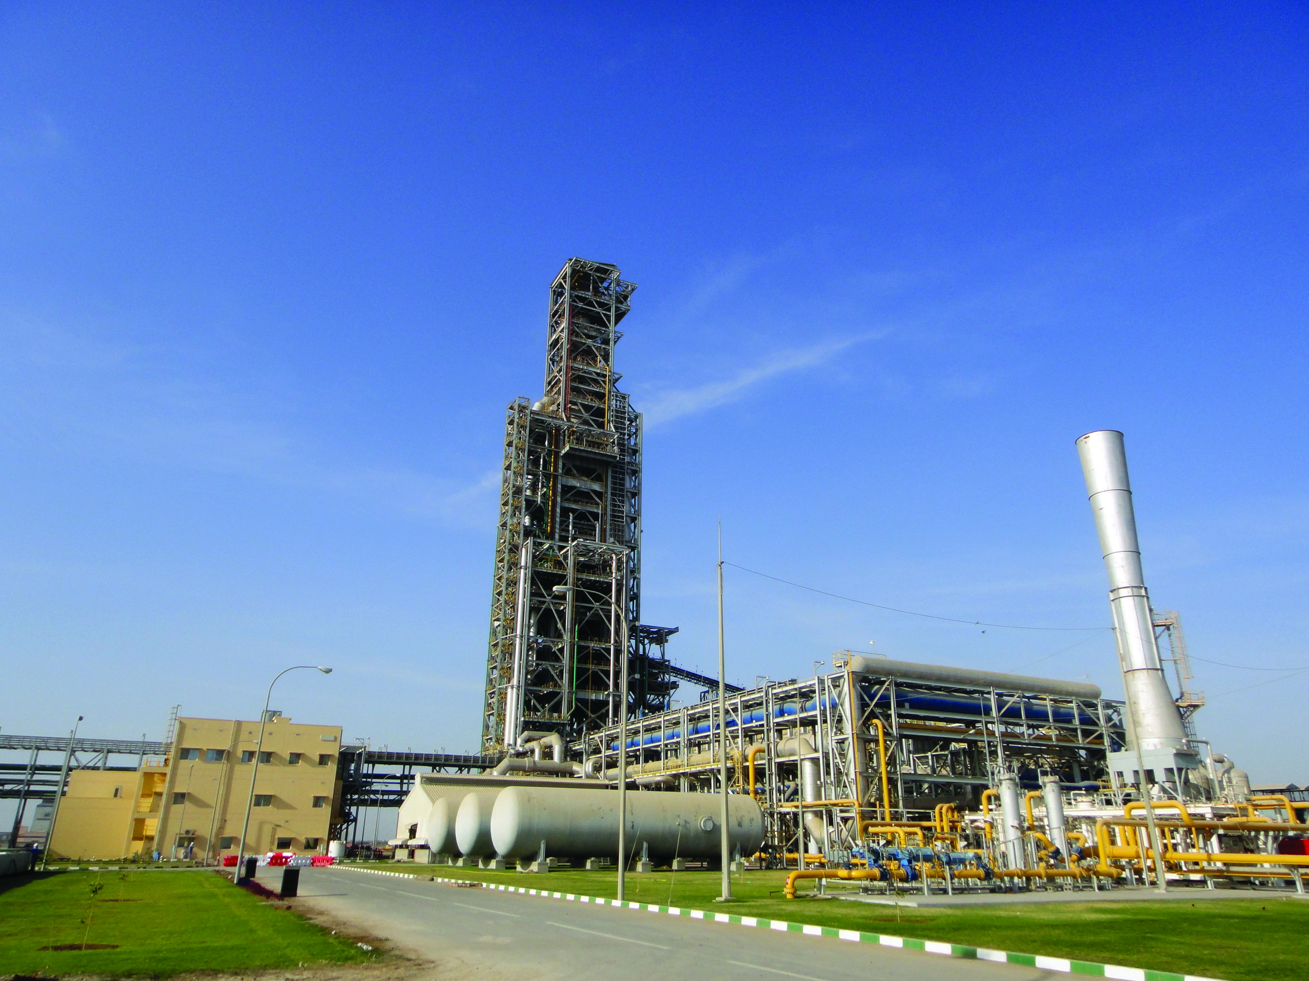
Overview of Steel Facilities
Raigarh
Angul
Patratu
Barbil
  Sponge Iron: 1.37MT
  Steel: 3.0MT
  Pig Iron: 1.67MT
  Rail & Universal Beam Mill: 0.75MT
  Plate Mill: 1.0MT
  Medium & Light Section Mill: 0.6MT
  Fabricated structures: 0.12MT
  Ferro Alloys: 36,000 T
  Power: 893 MW
  Cement Plant
  Plate Mill: 1.5MT
  SMS Plant: 1.6 MT
  Fabricated structures:
  84,000 T
  Power: 810 MW
  Wire Rod: 0.6MT
  Bar Mill: 1.0MT
  Pelletization Plant: 4.5MT
  Pelletization Plant: 4.5MT
  Steel capacity: 3.0 MT
  Power: 1,320 MW
Raipur
Oman
  Sponge Iron based on Coal Gasification: 1.8MT
  Coal Gasification Plant: 225,000Nm3/Hr
  HBI Plant: 1.6 MTPA
  Machinery & Castings:
  11,500 T
  Ingots: 30,000 T
  CF Castings: 3,000 T
  Phase 1: SMS Plant : 2MTPA
  Phase 2: Rebar & Section Mill: 2 MTPA
Operational
Under implementation

Slide 4
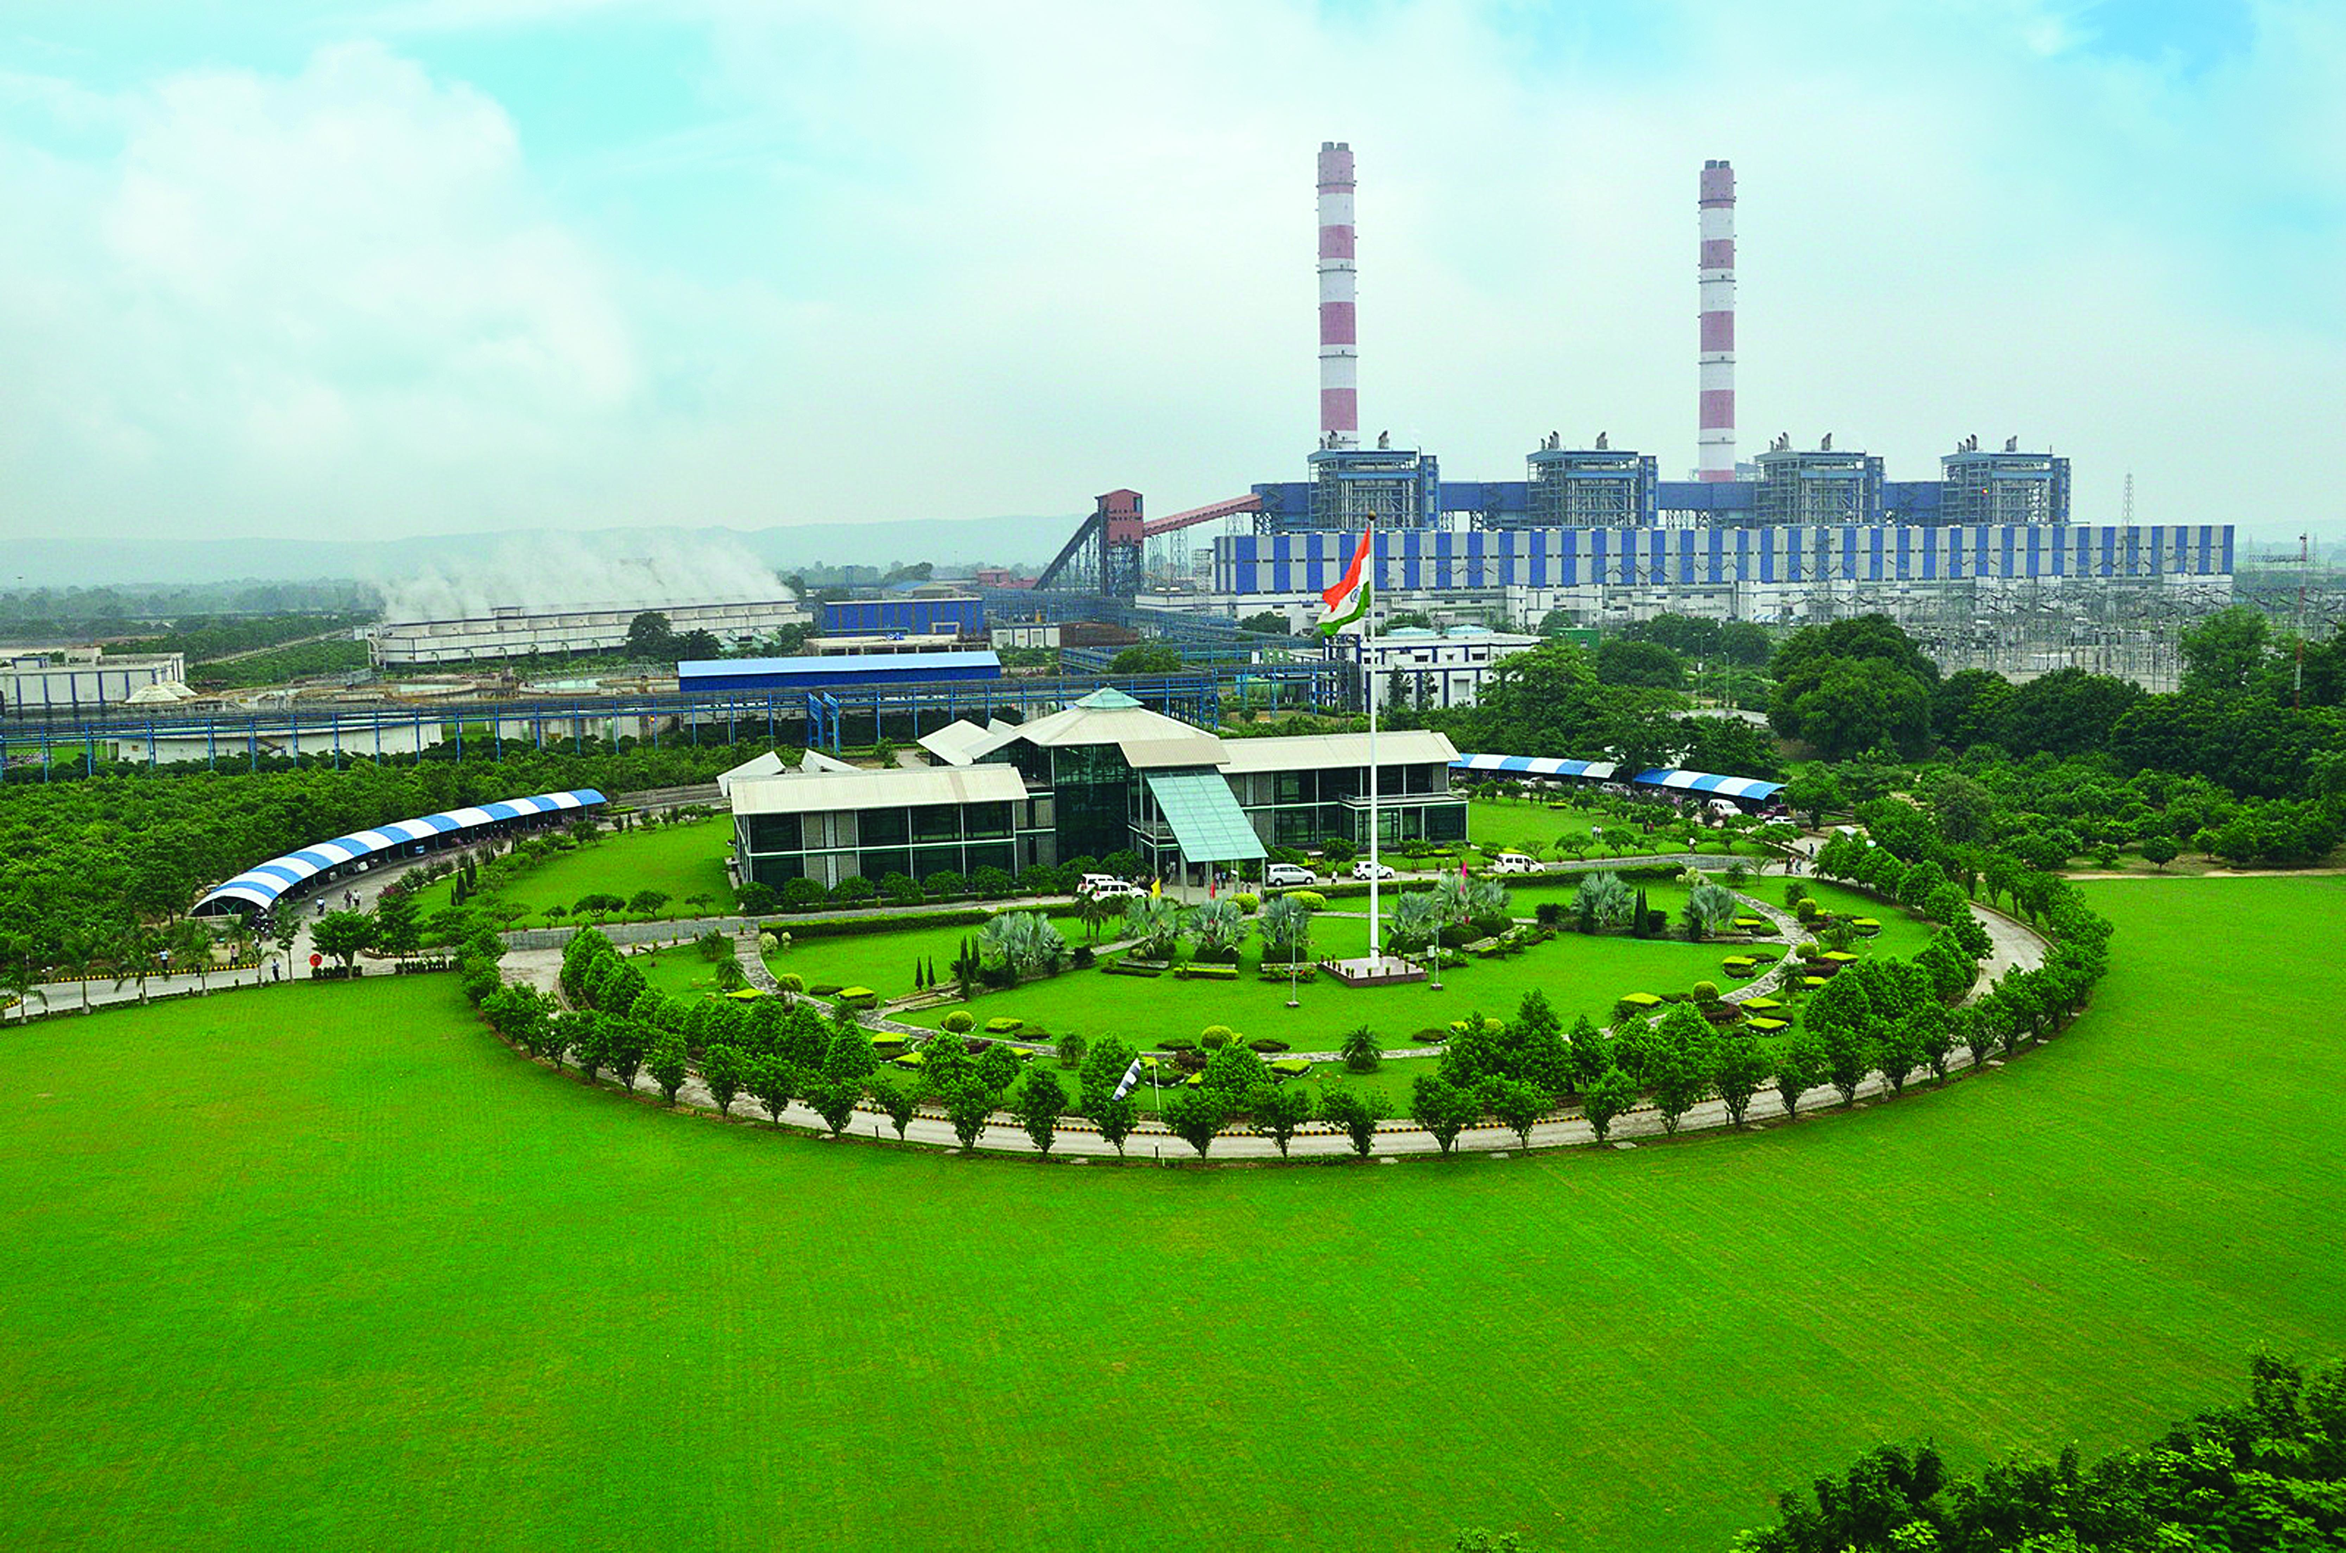
Jindal Power Ltd.
96.43% subsidiary of JSPL
1000 MW IPP operational in Tamnar, Chhattisgarh
2400 MW in advanced stages of completion at Tamnar
Projects Under Implementation (9,820 MW)
Project under JPL |  |  | Expected COD
Tamnar II (2,400 MW) | Thermal | Linkage | FY 2014-15
Hydro (6100 MW) | Hydro | Run Of The River
Project under JSPL
Godda (1,320 MW) | Thermal | Captive Mine
Projects Under Planning (1,980 MW)-JPL
Kineta (1980 MW) | Thermal | Linkage/imported coal

Slide 5
Our International Operations
Shadeed, Oman
Indonesia, Asia
  In 2010, JSPL acquired Shadeed Iron & Steel Co. LLC (Shadeed), which has installed a 1.5 MTPA steel plant with an investment of US$ 525 million and commenced production in January 2011
  Adding a steelmaking facility of 2 MTPA and will set up the first integrated steel plant in the Sultanate of Oman
    Phase 1: 2 MTPA Steel Making Product (Billet)
    Phase 2: 2 MTPA Rebar and Section Mills
  Invested for the development of two greenfield exploration assets in Indonesia
  Exploration License over 100 square kilometre in Central Kalimantan till Mar’18
  Medium to large size deposits of prime hard coking and low ash – low sulphur thermal coal for open-cast operation
  Acquired 17.7 hectares for the development of captive coal terminal for coal handling and barge loading at Barito River
Madagascar, Africa
  Plans to establish a cement plant in which will be supplied by its own limestone mines (reserves of over 1 billion tonnes)
Mozambique, Africa
  Developing a coal mine (10 MTPA) in Mozambique’s coal-rich Moatize region
  Coal resources estimated at 1.2 billion tonnes including coking coal
  Looking to set up a 2640 MW thermal power plant in the Tete region. Feasibility studies underway
Australia
South Africa, Africa
Botswana, Africa
  Secured six Exploration Permits for Coal (EPC) in Queensland with potential of exploring coking/PCI and thermal coal
  Signed an option agreement with Fitzroy Port terminal that has a capacity of handling 5 million tonnes of coal
  ~28% stake in ASX listed coal exploration company, Rockland Richfield Ltd (RCI). RCI has three advanced coal exploration projects with more than 750 MT of coal resources
  Headquarters for African operations
  JSPL’s Kiepersol Colliery produces about 1.2 MTPA of Anthracite coal, sold domestically and internationally Plans to ramp up capacity to 2 MTPA
  Acquired coal & iron ore concessions in which exploration and development is in progress
  Acquired CIC Energy in 2012 for 120 Mn USD
  Coal Mine with Resource of over 3 billion MT (high grade thermal coal)
  300 MW Power plant under planning
Coal assets
Steel production
Cement production
Notes:
Update the slide for Botswana

Slide 6
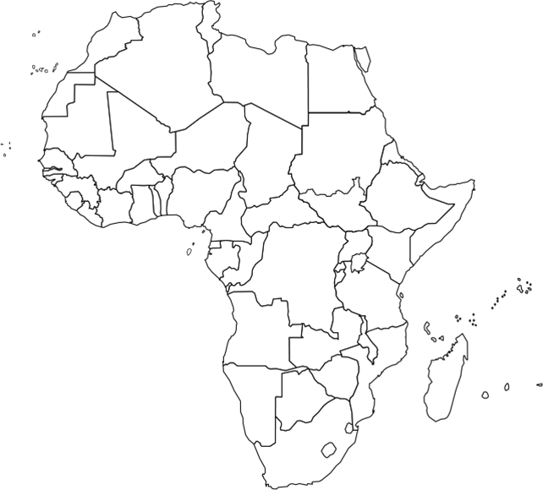
Our Power Projects in Africa
Senegal
2x175 MW TPP
Sierra Leone
2x125 MW TPP
Liberia
1x175 MW TPP
Botswana
4x171 MW TPP
Mozambique
2x21 MW CPP

Slide 7
Hard Facts About Africa
  Home to 15% of the world’s population that consumes just 3% of world’s electricity
  Across the continent only 10% of individuals have access to the electrical grid
  Annual consumption is 518 KWh in Sub-Saharan Africa, the same amount of electricity used by an individual in an OECD country in 25 days
  An average electrification rate of 24%, while the rate in the rest of the developing world lies closer to 40%
  Despite its unreliability, electrical service in Sub-Saharan Africa also costs more than in other parts of the world. The protective tariff required in Sub-Saharan Africa is $0.13 USD, compared to $0.04-$0.08 USD in the rest of the developing world
  Analysts have estimated a 1-5% impact on GDP of select African economies (Malawi, Uganda, South Africa, Senegal, Kenya, Tanzania) due to lack of electricity
  For the period 2011-2040, PIDA foresee the increase of energy demand from 590 TWh
  to 3,100 TWh & the installed capacity to grow from 120 GW to 700 GW
  USD 43 bn per annum required to meet the demand supply gap
Source: IEA, IRENA, Literature search, ADB, Program for Infrastructure Development in Africa

Slide 8
Hard Facts About Africa
  Home to 15% of the world’s population that consumes just 3% of world’s electricity
  Across the continent only 10% of individuals have access to the electrical grid
  Annual consumption is 518 KWh in Sub-Saharan Africa, the same amount of electricity used by an individual in an OECD country in 25 days
  An average electrification rate of 24%, while the rate in the rest of the developing world lies closer to 40%
  Despite its unreliability, electrical service in Sub-Saharan Africa also costs more than in other parts of the world. The protective tariff required in Sub-Saharan Africa is $0.13 USD, compared to $0.04-$0.08 USD in the rest of the developing world
  Analysts have estimated a 1-5% impact on GDP of select African economies (Malawi, Uganda, South Africa, Senegal, Kenya, Tanzania) due to lack of electricity
  For the period 2011-2040, PIDA foresee the increase of energy demand from 590 TWh
  to 3,100 TWh & the installed capacity to grow from 120 GW to 700 GW
  USD 43 bn per annum required to meet the demand supply gap
Source: IEA, IRENA, Literature search, ADB, Program for Infrastructure Development in Africa

Slide 9
Africa had a total of 147 GW of Power generating capacity in
2011; 40% of which was from coal based sources
Other
Renewable
1%
38 MW out of 59 MW of total coal power in Africa is produced in South Africa
Source: IEA 2011, Eskom

Slide 10
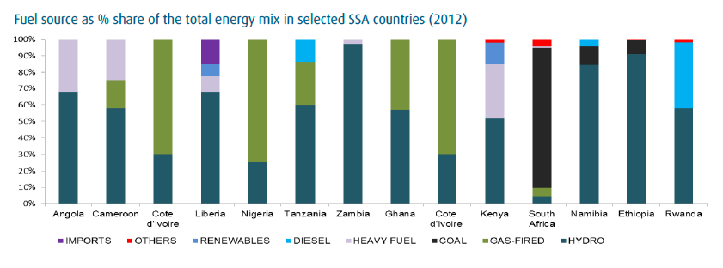
Other than South Africa, most of the generation in the continent is dependent upon Hydro or Gas Fired Power Plants
Energy majors like Nigeria and Egypt source more than 70% of their energy requirements from gas based plants
Source: Ecobank Power Sector Report 2014, wikipedia

Slide 11
Average electricity tariffs in Africa are higher than those in countries with dominant Coal & Hydro based power supply
Country | Average Tariff (US cent / Kwh) | Major Source of Power
India | 6 | Coal / Hydro
China | 8 | Coal / Hydro
South Africa | 11 | Coal
Russia | 11 | Coal / Hydro
US | 12 | Coal / Hydro
African Continent | 13 | Coal
Australia | 29 | Coal
  Inspite of being protected, tariffs in Africa are still higher than developing economies
  Low cost of electricity production from coal should translate into lower tariffs
  According to IEA statistics, coal-based electricity is, on average, 7% cheaper than gas and around 19% cheaper than nuclear
  IEA and European Commission studies show that onshore wind costs between US$50 and US$156 per MWh and PVs between US$226 to US$2031
  In certain locations hydro resources can produce electricity at a cost comparable to coal, however estimates vary greatly according to geographic conditions and the final price can be as high as US$240 and US$262 per MWh
  In comparison, electricity from coal costs between US$56 to US$82 per MWh
Source: IEA 2011, World Coal Association

Slide 12
What Africa Needs – Jindal Experience
  51 out of 54 countries in the African continent, account for more than 50% of energy consumption. The other three countries – South Africa, Nigeria & Egypt are largest consumers in Africa and also contributors to the Power Pools. Most of the other countries have a double or at best triple digit power demand in the next decade and can meet the demand by working on:
  Cheap and reliable power
  Low capex, small gestation period projects
  Base load power to meet basic demand
  Interconnected power pools
  Higher incidence of IPP participation
  Increase in electrification rate
Country | Demand | Supply
South Africa* | 35,364 MW | 34,970 MW
Nigeria | 16,000 MW | 5,000 MW
Egypt | 27,000 MW | 24, 500 MW
*Gap experienced for the first time in 2013. Expected to increase to 700 MW in
2014 due to delays in commissioning of Medupi Power Plant
Source: Daily News (Egypt), Nigeria Intel

Slide 13
Potential of Coal Power in Africa
Amongst all possible sources of power generation, coal based power plant is ideal to meet energy demands in Africa
Source | Average Development Period* | Capex | Type of Power | Ease of Expansion
Coal | 36 months | US$ 1 mn / MW | Base Load / Grid | Yes
Hydro |  |  | Peak Power / Grid | No
Oil |  |  | Base Load – Peaking / Grid
Wind |  |  | Peak Power / Grid –Off Grid | Yes
Gas |  |  | Base Load / Grid
Nuclear |  |  | Base Load / Grid | No
Solar |  |  | Peak Power / Grid –Off Grid | Yes
*300 MW

Slide 14
Incidence of Coal Deposits in Africa
  South Africa has 30 bn tonne of proven coal deposits, mines in excess of 250 mn tonne annually and exported 70 mn tonne of thermal coal from its Richards Bay Terminal in 2013
  Botswana has 7 bn tonne of proven & 212 bn tonne of estimated coal deposits, mines about 3 mn tonne annually
  Tete province in Mozambique is estimated to have 2.4 bn tonne of thermal coal
  Zimbabwe has 500 mn tonne of proven & 22 bn tonne of estimated coal deposits, mines about 2.4 mn tonne annually
  Nigeria has 400 mn tonne of proven coal deposits and is looking at ways to utilize it for power generation
  Kenya has 400 mn tonne of proven coal deposits and last year had auctioned 31 coal blocks with a view to utilize the coal for power generation
Source: Literature search

Slide 15
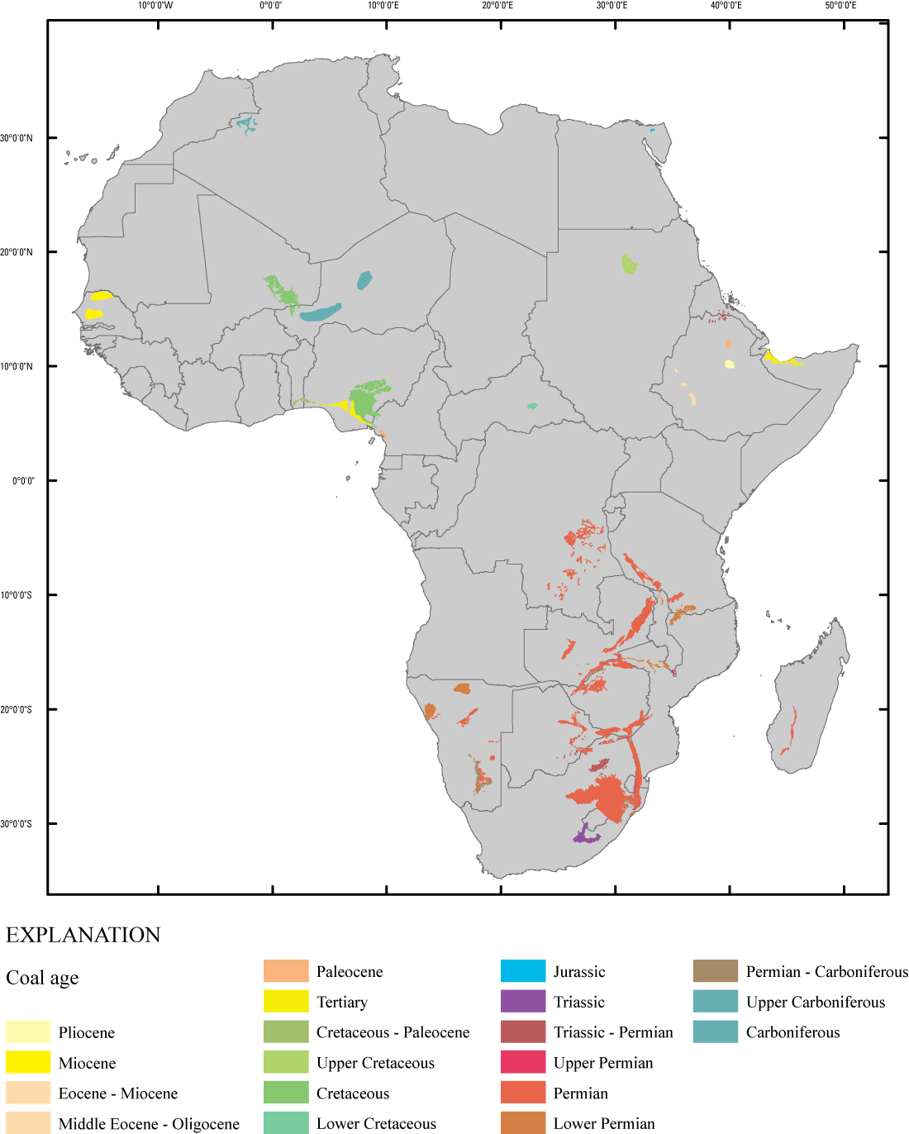
Coal Bearing Areas in Africa
Source: USGS

Slide 16
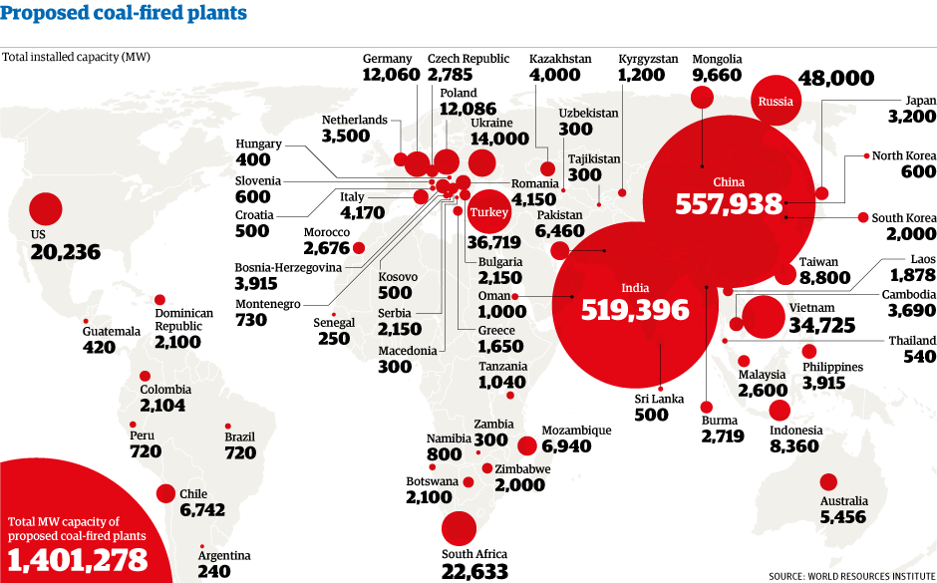
Just 3% of upcoming coal based MW capacity worldwide is based in Africa

Slide 17
South Africa has 92% of Africa’s proven coal deposits and exports 28% of its coal to other countries
Europe
India / Pakistan
S.E. Asia
S.E. Asia, India, Pakistan and Europe are major export destinations for South African coal

Slide 18
Africa’s own coal can be utilized to generate 24 GW in the next 5 years
Country | Coal Reserves | Coal Mined for Power in next 5 years | Total MW Generated
South Africa | 30 bn tonne (P) | 70 MTPA | 17,500
Botswana | 7 bn tonne (P) / 212 bn tonne (E) | 6 MTPA | 1,500
Mozambique | 2.4 bn tonne (P) | 5 MTPA | 1,250
Zimbabwe | 500 mn tonne (P) / 22 bn tonne (E) | 5 MTPA | 1,250
Nigeria | 400 mn tonne (P) | 5 MTPA | 1,250
Kenya | 400 mn tonne (P) | 5 MTPA | 1,250
  Assumptions
  South Africa after meeting its internal requirements exports balance coal within Africa only
  Average GCV of coal : 4,500 Kcal / Kg
  PLF: 85%
  Sub critical power plants
Source: Jindal Analysis

Slide 19
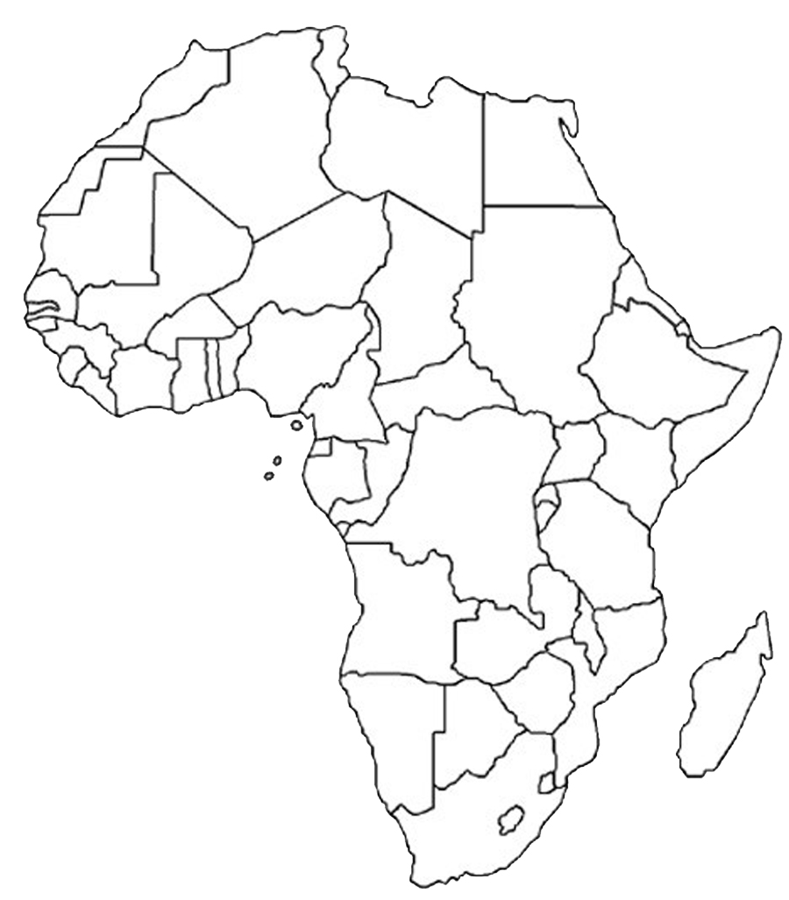
Africa’s vast coastline enables transport of coal with ease within Africa
Casablanca,
Morocco
Port Said,
Egypt
Djibouti
Lagos,
Nigeria
Mombasa,
Kenya
Dar es Salaam,
Tanzania
Walvis Bay,
Namibia
Beira,
Mozambique
Major Ports
Richards Bay,
South Africa
Source: Jindal Analysis

Slide 20
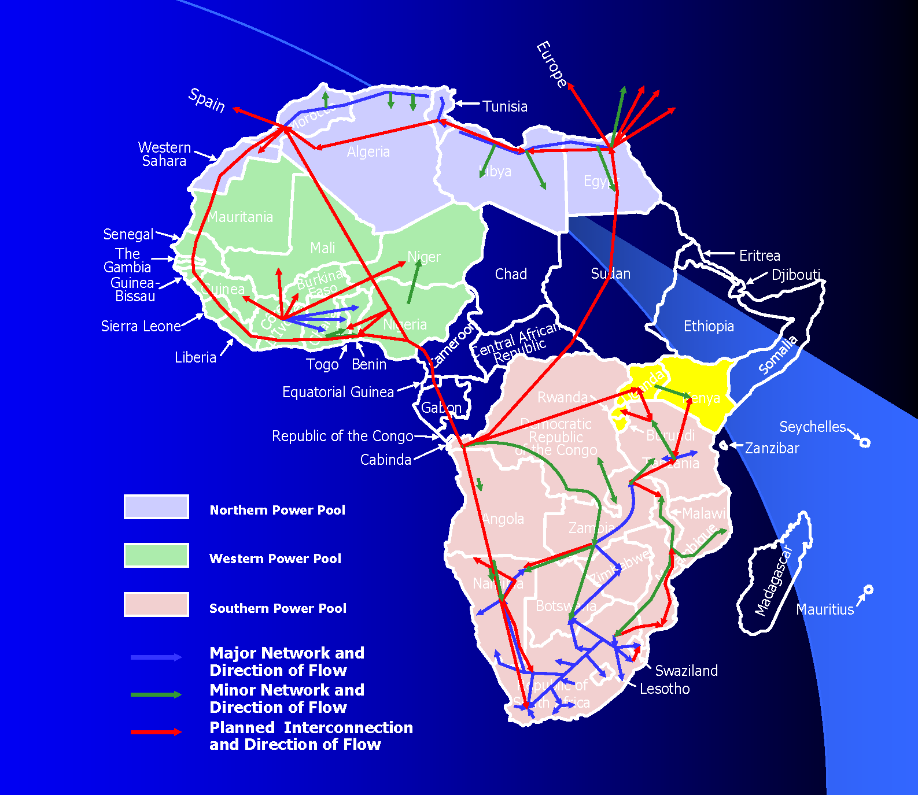
Well integrated power pool will serve small countries and central African region with ease from power centers
Source: AFDB

Slide 21
IPPs – Determinants of Success in Africa
  PIDA estimates USD 43 bn required annually till 2040 to meet the demand supply gap
  Total GDP of the African continent was USD 3,129 bn in 2011; top 10 economies contributing 75% to the total continent’s GDP
  With a host of other infrastructure, health, education, security issues it is difficult for most of the African nations to invest in capital intensive power plants and development of the power infrastructure
  According to ICA, by 2012, 23 IPP projects in 11 countries were at various stages of development. Successful programs exist in South Africa, Nigeria, Kenya, Uganda, Togo, Cote d’Ivoire, Senegal
  IPPs help African governments to bring in requisite finance for developing the power plant, enable efficient utilization of natural resources, generate employment opportunities, develop infrastructure in and around the project

Slide 22
IPPs – Support Required from African Governments
  Securing access to natural resources
  Provision of suitable site for setting up the plant
  Partner in development of enabling infrastructure for the project eg. Telecom, roads, rail etc.
  Provision of licenses, permits, approvals required to develop a mine and/or power plant
  Secure PPA so as to enable raising of finances from financial institutions
  Relaxation in state taxes, tariffs across the value chain of mine / power plant development

Slide 23
Clean Coal Technologies
  Clean coal technology is a collection of technologies being developed to mitigate the environmental impact of coal energy generation
  Some of the techniques that would be used to accomplish this include:
    Chemically washing minerals and impurities from the coal
    Gasification
    Treating the flue gases with steam to remove sulfur dioxide, carbon capture
    Storage technologies to capture the carbon dioxide from the flue gas
    Dewatering lower rank coals (brown coals) to improve the calorific value, and thus the efficiency of the conversion into electricity

Slide 24
Thank you

